Slide 2
Notes:
In one minute, how many different emotions can pupils think of? Write them on sticky notes, then ask pupils to come and stick them up. Feedback together as a class, reading out some of the emotions they have listed.

Slide 3
Notes:
Introduce the resource. Display the Learning objective and tell pupils what they will be doing today.

Slide 4
Notes:
Before beginning, agree on your own class version of Olaf’s Ground Rules for respectfully talking and listening to others.

Slide 5
Notes:
Show pupils a list of emotions that are also featured on the Emotion Cards. Compare with your class list and ask if there any emotions that pupils need a definition for. You could ask the class if any other pupils can define these.

Slide 6
Notes:
Play See how I feel, a game to understand more about the different feelings. Give each pupil one of the Emotion Cards. Ask them to move around the class and mime to one another an action to represent the emotion card they hold in their hands. How many can they guess correctly in three minutes? You could do this in small groups or as a class with pupils moving around once they guess correctly.

Slide 7
Notes:
Show pupils the Check-in Board, showing a range of moods from Feeling good to Not great – I’d like a check in. Ask pupils to write their name on the back of a sticky note then come and place it on the board at some point in the lesson. You could place the board at the back of the room or somewhere discreet. You can later check the names of pupils who are feeling low and speak to them privately later if they wish.

Slide 8
Stop and Think
Like everyone, Olaf has lots of different emotions that come and go. Sometimes, this can get confusing. How would you answer some of Olaf’s questions about his feelings?
What are emotions?
Are emotions good or bad?
Can emotions make Olaf do things?
Does Olaf have any control over the way he feels?
How could Olaf manage his emotions?
Notes:
Explain to the class that Olaf has lots of different emotions. In pairs or small groups, asks pupils to discuss the following questions then be ready to feedback.

Slide 9
Freeze for 10
This is a great strategy to use if you are feeling overwhelmed.
Wherever you are, whatever you are doing, just…
Freeze
Breathe
Count to 10
How do you think this will help?
Notes:
Introduce this strategy to help pupils when they feel a strong and overwhelming emotion. Before acting, they should always try to freeze, breathe and count to ten. Practice as a class and explain that pupils can always come back to this technique when needed.

Slide 10
Emotion Clouds
In groups, use your Emotion Cards to create your own emotion clouds like this one, and display around the classroom.
What temperature?
Feels like…
EMOTION
You might feel this when…
Draw an emoji or image
If it was a type of weather, it would be…
If it was an animal, it would be…
A good thing to do if you feel this is…
What colour?
Notes:
Place the class into small groups, each with their Emotion Cards. Together, they should create Emotion Clouds like the example on the slide. Ask pupils to pin their clouds up around the room and encourage young people to volunteer to read theirs aloud for the class.

Slide 11
Stop and Think
Why are emotions similar to clouds?
How could you think of emotions like clouds when you Freeze for 10?
Notes:
Ask pupils to consider why emotions are like clouds? Explain to pupils that clouds and emotions can seem big but that they drift away, especially if we take a moment to breathe. Explain that Freeze for 10 can be modified where they think of their thoughts and feelings like clouds drifting away. Help them understand that sometimes emotions might not feel as though they will drift away, but that’s ok too.

Slide 12
Notes:
Introduce the different characters (Anna, Elsa, Kristoff, Olaf) and explain that pupils will be exploring how they feel in different situations.

Slide 13
Notes:
In pairs, give pupils the names of a character (they should be distributed equally to form groups of all four characters when using the puppets. Give each pair a Head Heart Hands Activity Sheet and a Scenario Card, then ask them to complete the sheet, showing:
Head - what their character is thinking?
Heart - what their character is feeling?
Hands - what their character might do or say?
Pupils could refer back to the Emotion Cards to help. Once complete, join the pairs into groups of four different characters (eight pupils) to discuss how the scenario could play out in different ways. What would be the most positive solution for everyone?

Slide 14
Showtime
Now it’s time to turn your ideas into a show using puppets of the characters from Disney’s Frozen the Musical. Remember, you don’t need to stick to the original plot. Be creative!
How can you show the characters resolving one of the scenarios?
How would their character feel?
How would this come through in their actions and words?
How will different characters respond to each other?
Can you show the characters using a Freeze for 10 moment?
What is a positive action they could take in this situation to make things better and resolve the situation?
Notes:
Pupils should now use their learning to create a short play with the puppets. See page 12 of the Teacher Notes for a detailed explanation of how to build and use the puppets.

Slide 15
Disney’s Frozen Wellbeing Lesson 2: Friendship
We are going to be learning about Wellbeing through the characters who appear in the Disney’s Frozen the Musical stage show.
In today’s lesson, we will learn about the qualities of friendship and explore how to be a good friend.
Keywords
Friendship, qualities, respect, truthfulness, trustworthiness, loyalty, kindness, generosity, trust, admire.
Notes:
Introduce the resource, display the Learning Objective and tell pupils what they will be doing today. You could remind them about the Check In Board and Olaf’s Thought Jar, if using. You could also choose an anonymous note from Olaf’s Thought Jar and ask the class to try and solve it together, (making sure the pupil is not recognized by the group).

Slide 16
What are the qualities of friendship?
Let’s create a mind map to show what makes a good friend
FRIENDSHIP
Notes:
In pairs, or small groups, ask pupils to create a mind map which shows all the qualities of good friendship then feedback as a group.

Slide 17
Good Friendship
These are the five qualities that make a fantastic friend
Respect
Trust
Loyalty
Kindness
Generosity
Notes:
Present the qualities that pupils will be exploring further: respect, trust, loyalty, kindness, generosity and trust. Check pupils’ understanding of the terms.

Slide 18
Friendship Freezeframes
In pairs, create freezeframes for each of the qualities. Be ready to show one of yours to the class and see if they can guess what it is.
Notes:
Ask young people to work in pairs. For each of the 7 qualities of friendship introduced in the starter, ask the pairs to create a freezeframe for each one. Then, shine the spotlight on different pairs and ask them to demonstrate a freezeframe and see if the class can guess which quality of friendship each pair is trying to show.

Slide 19
Stop and Think
Olaf has lots of friends who really value him because of his fantastic qualities. Ask pupils to consider the following questions:
Why is friendship important?
How do friends make us feel?
Why do we need friends?
How should good friends treat each other?
Insert image – Olaf with others demonstrating friendship
Notes:
Explain to the class that Olaf has lots of different friends. In pairs or small groups, asks pupils to discuss the following questions then be ready to feedback.

Slide 20
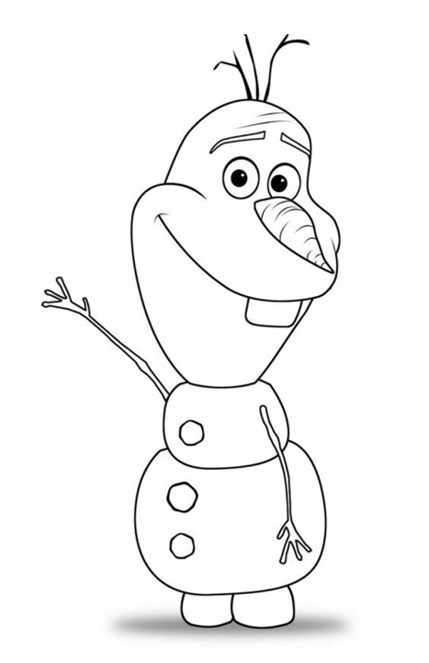
My Amazing Friend
Would you like to have an amazing friend like Olaf?... Well you already do! Use Olaf to help you write about a friend that is close to you.
Inside the outline of Olaf, write all the things you admire about that friend
Outside the outline of Olaf, write how that friend can make you feel.
Notes:
Slide 20: My Amazing Friend Hand out the My Amazing Friend Activity Sheet and ask pupils to complete the activity sheet individually. You can model this first using the image on the slide. Request that someone volunteers to share their work with the rest of the class. As the pupil reads from their activity sheet, ask the rest of the class to imagine that the pupil is talking about each class member individually. Then, ask everyone how it felt to have a friend that values you? Pupils could use their sheets to create a friendship display.

Slide 21
Stop and Think
Olaf has lots of friends and loves to spend time with them. One day, he hears about a party at the palace that he hasn’t been invited to. Olaf feels left out and extremely hurt.
What are some of the problems that can happen in friendships?
How can they make us feel?
How can we resolve issues that can happen between friends?
What could Olaf do in this situation?
Notes:
Explain that Olaf has lots of friends and loves to spend time with them. One day, he hears about a party at the palace that he hasn’t been invited to. Olaf feels left out and extremely hurt.
What are some of the problems that can happen in friendships?
How can they make us feel?
How can we sort/resolve issues that can happen between friends?
What could Olaf do in this situation?
Feedback as a class.

Slide 22
Freeze for 10
Can you think of a time when you had a difficulty with a friend?
Try the technique of freeze for 10 and think about what would improve things. What does empathy mean and how could it help us?
Freeze
Breathe
Count to 10
Notes:
Ask pupils to imagine a time when they had a difficulty with a friend. They should Freeze, Breathe and Count to 10 while they think about what they could do to improve things. First, explain what empathy is and ask pupils to think about things from their friend’s point of view too. Afterwards, you could ask pupils to discuss their thoughts if they feel comfortable.

Slide 23
Notes:
Introduce the different characters (Anna, Elsa, Kristoff, Olaf) with a slide showing facts about them and their relationships to each other.

Slide 24
Notes:
Pupils will work in into groups of 8, (2 people per character and 4 characters per group). Introduce the Scenario Cards and hand out one to each group of 8. (Making sure it is different to one they may have undertaken in a previous lesson). This time, rather than thinking about how their character would feel in this scenario, they should imagine how one of the other characters might feel and how they could help and support that friend. You could use the Head Heart Hands Activity Sheet from Lesson 1 and refer to the Emotion Cards for help. Feedback as a whole class.

Slide 25
Notes:
Pupils should now use their learning to create a short play with the puppets. See page 12of the Teacher Notes for a detailed explanation of how to build and use the puppets.

Slide 26
Disney’s Frozen Wellbeing Lesson 3: Trust
We are going to be learning about Wellbeing through the characters who appear in the Disney’s Frozen the Musical Stage Show.
In today’s lesson, we will learn about the meaning of trust and exploring trustworthy qualities in ourselves and the people we know, as well as learning how to ask for help and advice in certain situations.
Keywords
Trust, trustworthy, untrustworthy, welcoming, reliable, honest, dependable.
Notes:
Introduce trust, the theme of the session, display the Learning Objective and tell pupils what they will be doing today. You could remind them about the Check In Board and Olaf’s Thought Jar, if using. You could also choose an anonymous note from Olaf’s Thought Jar and ask the class to try and solve it together, (making sure the pupil is not recognized by the group).

Slide 27
What is Trust?
Write down your own definition of trust.
The firm belief in someone or something
Notes:
In pairs, or small groups, ask pupils to write down what they think trust means. Then on a click reveal the definition: The firm belief in someone or something. Discuss examples of this and ask pupils to share their own.

Slide 28
Trust Me!
We are going to play a game of trust. It’s time to place your trust in your partner…
1) Stick the tail on Sven Can you guide your partner to stick the nose on Sven?
2) Frozen Walk Can you lead your partner around the forest with their eyes closed. Watch out for logs!
3) Olaf’s nose Together, can you balance Olaf’s nose together on one index fingers and lower it to the ground?
Notes:
Stick the carrot on Olaf: Ask one pupil in the pair to close their eyes and then stick the carrot on Olaf. Before starting, give a secret message to the unblindfolded pupil. The pupil who sticks the carrot on Olaf can decide on whether they want the unblindfolded person in their pair to guide them. Pupils will have to decide on whether they feel they can trust the person to help them complete the task successfully.
Frozen Walk: Ask one pupil to close their eyes while the other guides them around the classroom/school by giving vocal instructions. Swap roles and repeat.
Olaf’s nose: Ask each pupil to hold out one index finger. Balance a carrot, (or other suitable object) on their fingers. Inform pupils that their challenge is to lower it to the ground without losing contact with anyone’s finger.

Slide 29
Notes:
In pairs or small groups, asks pupils to discuss the following questions then be ready to feedback.

Slide 30
Circle of Trust
There are lots of people in our lives, but how do we know who we can trust the most?
Place the examples of people you know in different circles of trust.
HINT: The trust is stronger the closer to the centre. So make sure you place only the people you trust a lot in the centre circle.
Notes:
Hand out the Circle of Trust Activity Sheet and explain to pupils that there are different levels of trust we have in people. The sheet is designed with concentric circles to represent varying levels of personal trust. Ask pupils to place the examples on the sheet into the circle they feel is most appropriate. Ask pupils to complete the activity sheet individually then feedback work as a class.

Slide 31
T im
Insert image of Olaf
Notes:
Explain that Olaf is so friendly, he always talks to new people and wants to help them if they ask him. One day he meets a lone traveller in the forest who asks if he wants to come along with him on his journey. Olaf wants to say yes! But should he?
What could Olaf do in this situation?
Who could help him in this situation?
How do we stay safe and protect ourselves when meeting new people?
Who can we talk to if we think something or someone might not be trustworthy?

Slide 32
Freeze for 10
Can you think of a time when you weren’t sure whether to believe something someone told you?
Try the technique of freeze for 10 and think about how you could deal with this situation.
Freeze
Breathe
Count to 10
Notes:
Ask pupils to imagine a time when they might have not believed something that someone said. They should Freeze, Breathe and Count to 10 while they think about what they could do or say in that situation. You could ask pupils to share their thoughts and feelings.

Slide 33
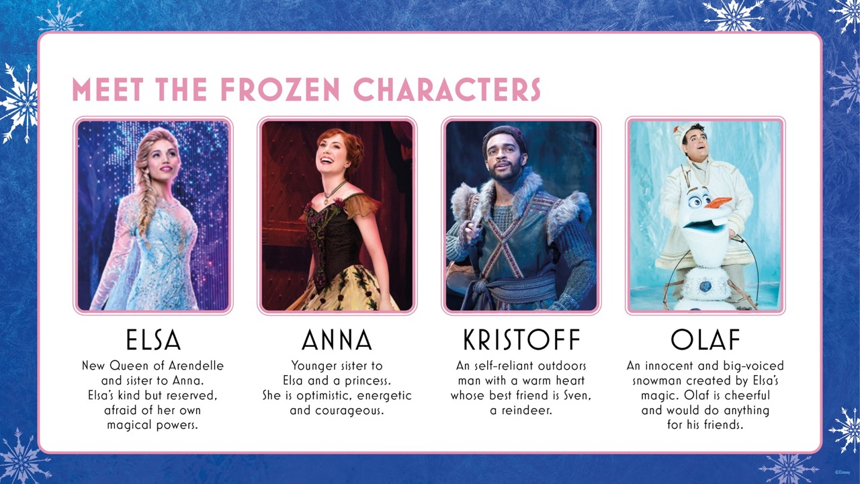
Meet the Frozen Characters
Design: in 4 boxes with images
ELSA Reserved and hesitant, yet naturally regal, Elsa is a dedicated new Queen of Arendelle. However, she has been trained for over a decade to fear and hide her magical powers.
ANNA The optimistic and enthusiastic Princess of Arendelle. Naturally funny and courageously fearless, her greatest flaw – and her greatest strength – is her faith in love.
KRISTOFF An orphan raised by Hidden Folk in the forest, Kristoff is a self-reliant ice-seller and Mountain Man whose best friend is a reindeer. Kristoff is naturally warm with a good heart.
OLAF A big-voiced snowman created by Elsa’s magic, Olaf is caring and innocent, completely content to be anywhere, doing anything. Olaf always does his best to look on the bright side of things and will do anything to help his friends.
Notes:
Introduce the different characters (Anna, Elsa, Kristoff, Olaf) with a slide showing facts about them and their relationships to each other.

Slide 34
Making Promises
In pairs, you will be given a character and a Scenario Card. Using the Head Heart Hands Activity Sheet think about how your character could make a promise to someone.
What emotions are involved in making promises?
How do you know if people will keep or break a promise?
What could the characters do to try and keep the promise?
Now, join into groups of four characters to discuss the different scenarios and promises your characters might make or break. Do you agree with each others’ ideas? What else might happen?
Notes:
Pupils will work in into groups of 8, (2 people per character and 4 characters per group). Introduce the Scenario Cards and hand out one to each group of 8. (Making sure it is different to one they may have undertaken in a previous lesson). They will examine the effect of making and breaking promises on others. Pupils can refer to the Emotion Cards for help. Feedback as a whole class.

Slide 35
Notes:
Pupils should now use their learning to create a short play with the puppets. See page 12 of the Teacher Notes for a detailed explanation of how to build and use the puppets.

Slide 36
Notes:
Introduce uniqueness, the theme of the session, display the Learning Objective and tell pupils what they will be doing today. You could remind them about the Check In Board and Olaf’s Thought Jar, if using. You could also choose an anonymous note from Olaf’s Thought Jar and ask the class to try and solve it together, (making sure the pupil is not recognized by the group). If the jar is working well, you could continue to keep up the habit and share pupils’ thoughts.

Slide 37
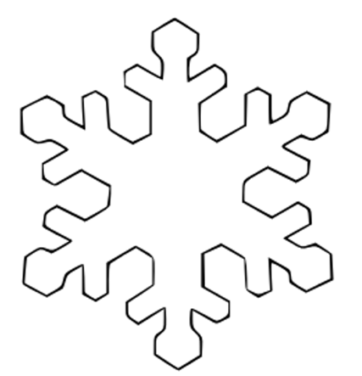
Notes:
Show pupils a picture of a snowflake and ask them their thoughts. Feedback as a class. Inform pupils that there are no two snowflakes that have ever been exactly the same. Every single snowflake is different to any that have come before. They are unique. As a class discuss the meaning of the word unique: being the only one of its kind; unlike anything else.

Slide 38
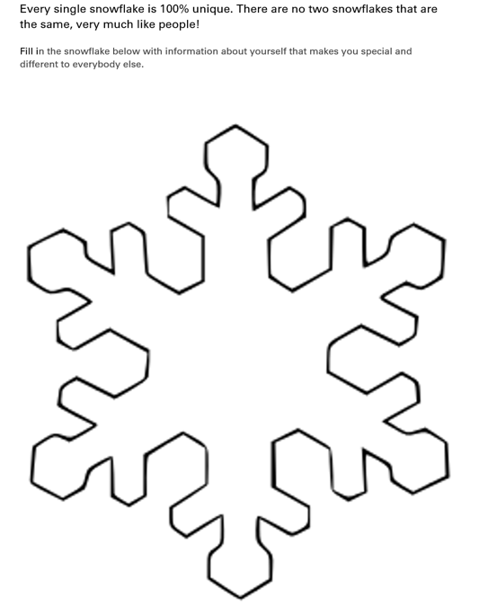
What Makes You Unique?
Add image of the snowflake activity sheet
Complete your own snowflake to show what makes you unique!
For example, Olaf is a fantastic listener! He always takes the time to listen to is friends and help them try to see the positive in a challenging situation.
Notes:
Inform pupils that everyone has something special that makes them unique. It may be a skill or talent, or perhaps a characteristic such as being kind or caring in a certain way. Use the example of Olaf on the slide to given them some ideas. Hand out the Snowflake Activity Sheet and ask pupils to complete the activity sheet individually.

Slide 39
Stop and Think
Olaf is incredibly friendly. He makes everyone he meets feel warm and welcome. Although he is a Snowman, Olaf has the warmest heart.
Are any two people the same?
How can we make everyone feel included while also celebrating differences?
What can you do to show someone you appreciate the things that make them unique?
Insert image of Olaf
Notes:
Explain that Olaf is incredibly friendly. He makes everyone he meets feel warm and welcome. Although he is a Snowman, Olaf has the warmest heart.
Are any two people the same?
How can we make everyone feel included while also celebrating differences?
What can you do to show someone you appreciate the things that make them unique?

Slide 40
Freeze for 10
Think of a time when you may have incorrectly thought something about someone they did not know very well.
Try the technique of freeze for 10 and think about how it might feel if someone makes incorrect assumptions about you. What can we do to be welcoming towards others and celebrate their uniqueness?
Freeze
Breathe
Count to 10
Notes:
Ask pupils to imagine a time when they might have not believed something that someone said. They should Freeze, Breathe and Count to 10 while they think about what they could do or say in that situation. You could ask pupils to share their thoughts and feelings.

Slide 41
Combining Forces
Let’s see what makes others unique! Move around the room and read the snowflakes.
Imagine if we combined that power.
We are much stronger together! How does combining people’s uniqueness help situations?
Why should people feel good about being unique?
Think of each character in Frozen. What positive characteristics do they have?
Notes:
Ask pupils to place their snowflakes on the table and in silence, ask pupils to move around the room so that they can read each other’s snowflakes and are able to learn about how each person is unique and special. Place pupils in small groups of three or four and explain that together, people are stronger. Ask pupils to discuss in their groups what they think is possible if they all combined their unique characteristics?

Slide 42
Celebrating Differences
We are going to create our own snowflake bunting, showing how everyone is unique.
Be ready to thread your bunting as the string comes around and shout out what makes you unique!
Notes:
Ask pupils to stand in a circle and hold up their snowflakes from the Snowflake Activity Sheet. Pass a string to each person in the class so that all of the snowflakes can be joined together. Direct pupils in the circle to one by one shout out one thing that makes them unique as they thread their snowflake. Hang the snowflake bunting in the class to remind pupils that everyone is different, and unique. For pupils who do not want to shout out one thing that makes them unique, they can ask a friend to say it for them or write it in big letters on a piece of paper and hold it up when it in their turn.

Slide 43
Final Performance!
In groups, use the puppets and scenario cards, or your own ideas, to come up with a final performance. Your stories must feature:
A problem
How different characters feel, think and act (Head heart hands)
An example of a character using Freeze for 10 to manage their emotions, and coming up with a strategy to act positively
A final resolution
Prepare to perform this back to the whole class, or in a whole school assembly to teach others about the wellbeing strategies you have learned.
Notes:
Explain to pupils that they will use the puppets and scenario cards, or their own ideas, to come up with a final performance. Their stories must feature:
A problem
How different characters feel, think and act (Head heart hands)
An example of a character using Freeze for 10 to manage their emotions, and coming up with a strategy to act positively
A final resolution
Prepare pupils to perform this back to the whole class, or in a whole school assembly to teach others about the wellbeing strategies they have learned.
During the final performance, you could begin by sharing examples from the Secret Kindness Mission Logs.
Pupils could either stay anonymous or stand up and claim their kindness!

